Slide 1
Thursday 7th January 2021
LI: To explore the suffix -ful
The -ful suffix changes a noun to an adjective.
Adding the -ful suffix changes the meaning of the word to ‘full of’ + root word.
Pain + ful – painful meaning full of pain
Activity 1 - Watch -ful (& less) video by Espresso
https://central.espresso.co.uk/espresso/primary_uk/subject/module/video/item910813/grade1/module910304/collection910346/section911022/index.html?source=search-all-all-all-all&source-keywords=ful%20suffix
Espresso: Username Student28779 Password: esherchurch
Activity 3
Explain what happens to the spelling of the root word (noun) when it ends in y?
Replace the y with an i
pity + ful becomes pitiful
wish + ful
hope + ful
forget + ful
Pity + ful
hate + ful
beauty + ful
pain + ful
success + ful
Activity 2
Copy the nouns and add the suffix –ful to change them into adjectives.
Check the spellings of the adjectives made.

Slide 2
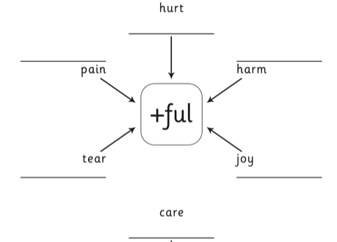
Activity 4 – Copy the spider diagram and add the ful suffix to make adjectives.
Take care when adding ful to words ending in y.

Slide 3
The suffix -ful
The -ful suffix changes a noun to an adjective.
Adding the -ful suffix changes the meaning of the word to ‘full of’ + root word.
Pain + ful – painful
Activity 5 - Read the sentences. Add -ful to the noun to complete the sentence.
Write the sentences in your book and underline the adjectives you have made.
The dog looked at the bone with __________ eyes.
Grandma seemed very _________________ with her family around.
When I fell off my bike onto the rocks it was very ______________.
The sunflower was ________________.
That was a _________________ thing to say to your brother.
I can be so ________________ sometimes!
I am ______________ that it will snow in January.
The cat looked _____________ purring outside in the freezing cold.
wish + ful
cheer + ful
pain + ful
beauty + ful
hate + ful
forget + ful
hope + ful
pity + ful

