Slide 1
Friday 8th January 2021
LI: To explore the suffix –ness
The -ness suffix changes the word to a noun.
For example
sad + ness becomes sadness

Slide 2
Activity 1
Activity 2 - Explain
The –ness suffix
The -ness suffix changes the word to a noun.
Copy the words and add ness to them.
sad + ness
tired + ness
fair + ness
kind + ness
lovely + ness
fit + ness
foolish + ness
tidy + ness
happy + ness
Explain what happens to the spelling of the root word when it ends in y?
Replace the y with an i
Lovely + ness becomes loveliness
Activity 3 - Complete online
Online wordsearch for -ness
https://wordwall.net/resource/295916/english/suffix-ness
Activity 4 - Watch espresso video
Espresso: Username Student28779 Password: esherchurch
Watch video from 1.15 mins for ness suffix
https://central.espresso.co.uk/espresso/primary_uk/subject/module/video/item911513/grade1/module910304/collection910337/section911510/index.html?source=search-all-all-all-all&source-keywords=suffix%20ness

Slide 3
The suffix –ness
The –ness suffix changes the root word to a noun.
sadness
tiredness
fairness
kindness
loveliness
fitness
foolishness
tidiness
happiness
Activity 5
1. Write each of these words in a sentence.
2. Underline the –ness word you have used.
3. Use capital letters and full stops.
4. Check the spellings of the words you have used.

Slide 4
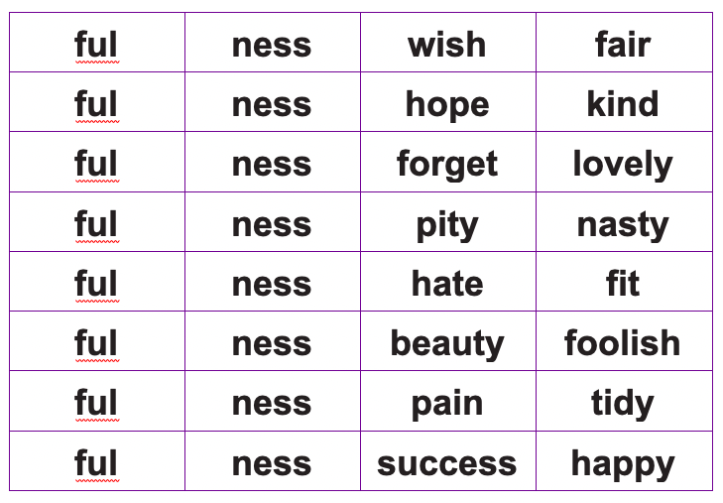
Activity 6
Add the suffix –ful or –ness to these root words to make new words. Check the spellings of the new words made.

