Slide 1
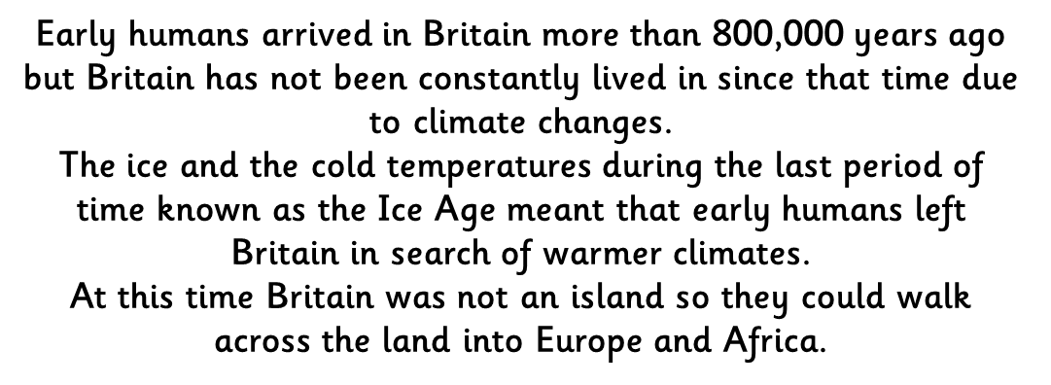
LI: To find out about the Stone Age

Slide 3
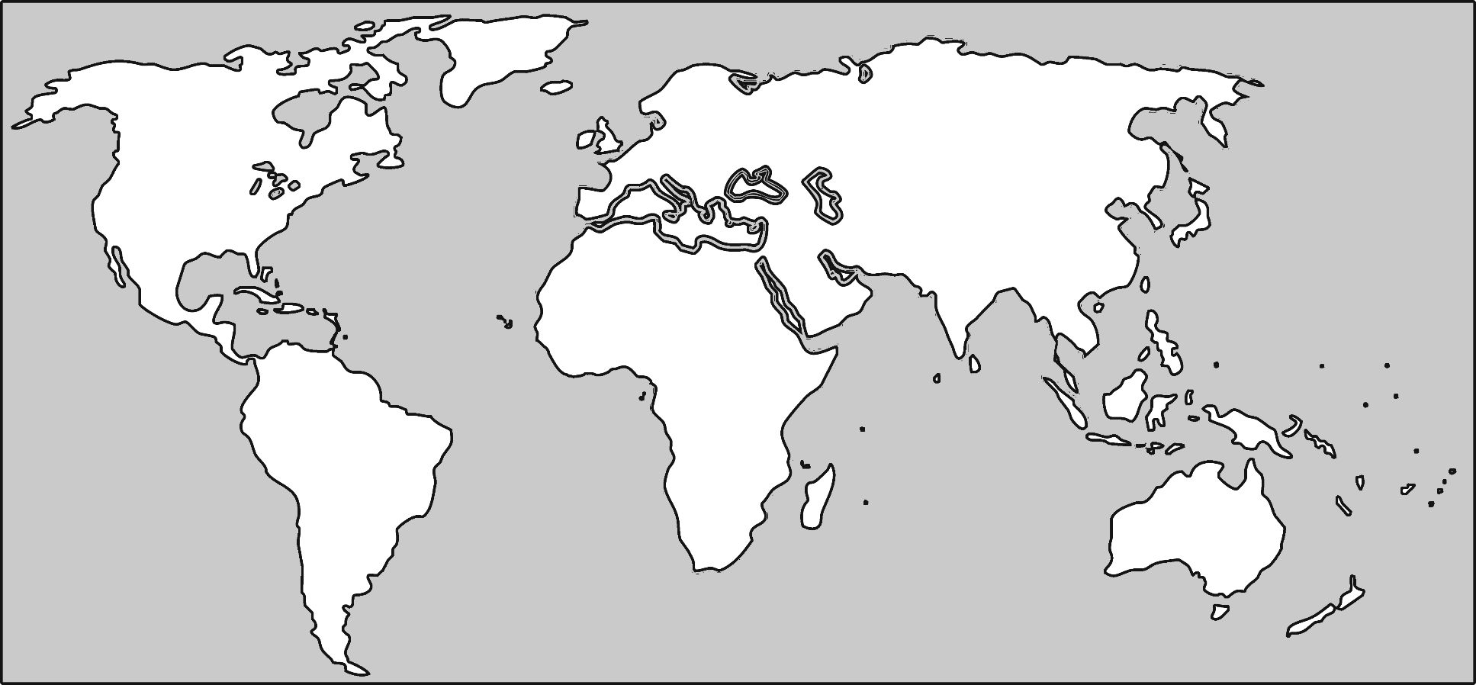

Slide 4
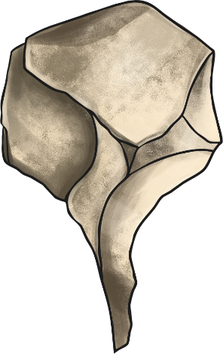
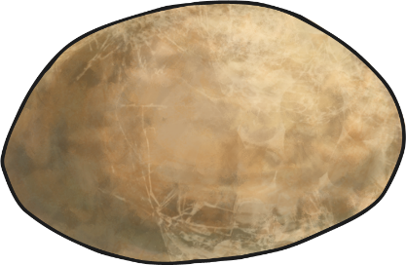
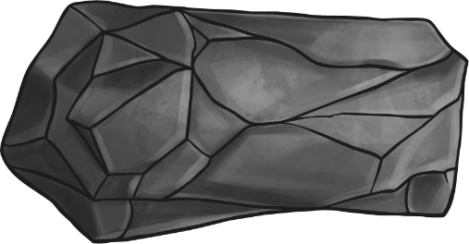

Slide 5
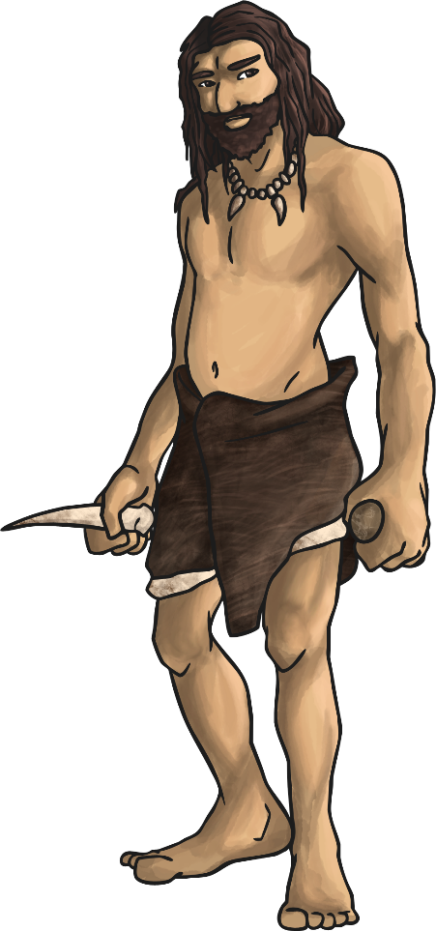
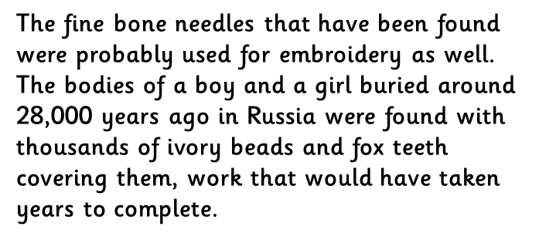
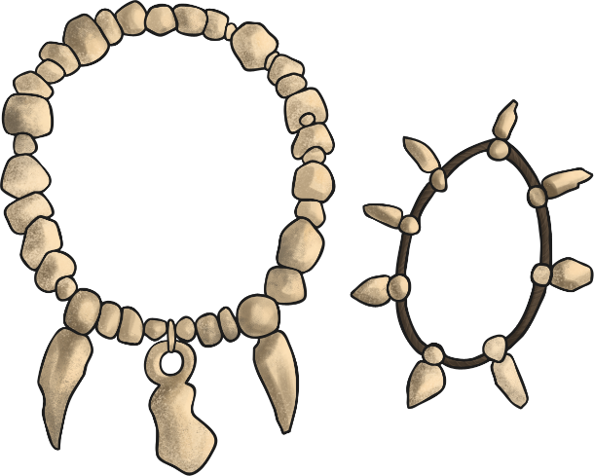

Slide 6
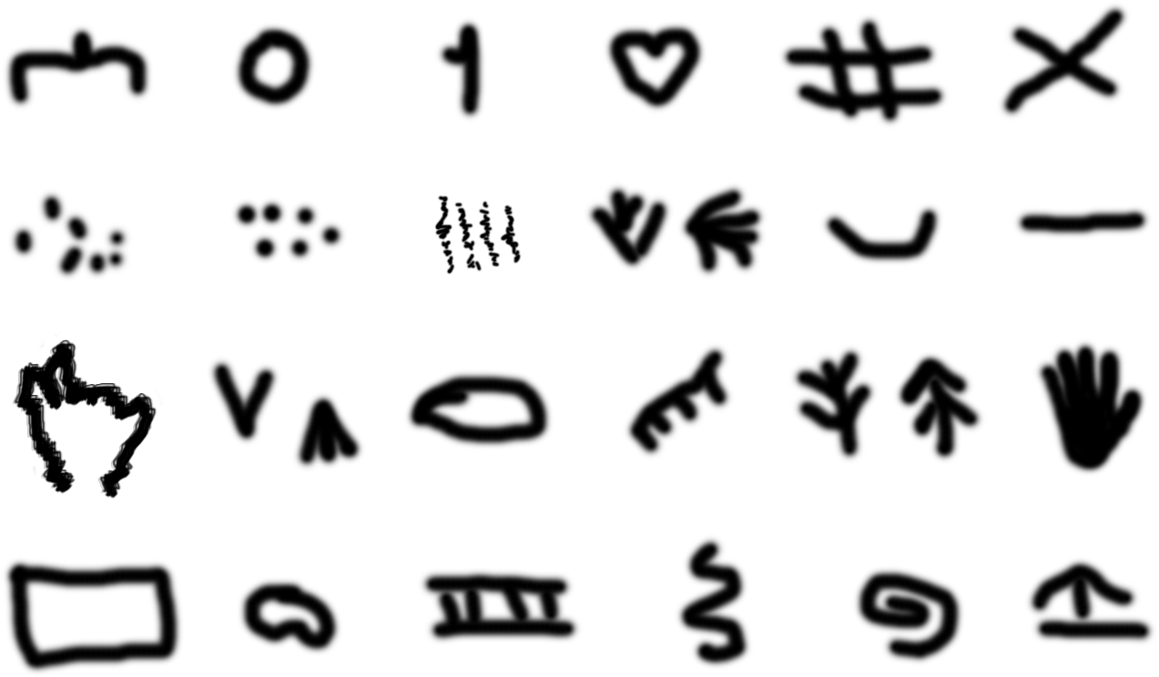

Slide 7
Now Now watch the video link below:
It is about the Middle or Mesolithic Stone Age
watch the video link below:
https://central.espresso.co.uk/espresso/primary_uk/subject/module/video/item754163/grade2/module754159/index.html
Activity:
With the help of the next slide make your own mind map to show what you know about the Stone Age, then use a different colour pen/pencil to write questions, also on the mind map, about what you would like to find out – use words like: How, Where and What.
Use a piece of plain paper for this, it doesn’t matter if it has other
printing on the back. When you have finished put it in a safe place
for future Big Enquiry lessons please.

Slide 8
What did they do?

