Slide 1
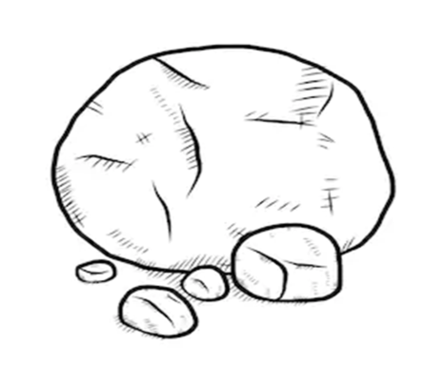
You are my Rock.
To understand why God is described as a rock and consider who we think of as Rocks in our own lives.
Dear God,
when things go wrong for us,
help us to know that we can trust in you,
for you are steady and strong as a rock.
In my life my rock is __________________________
because
Me and my Rock!

