Slide 1
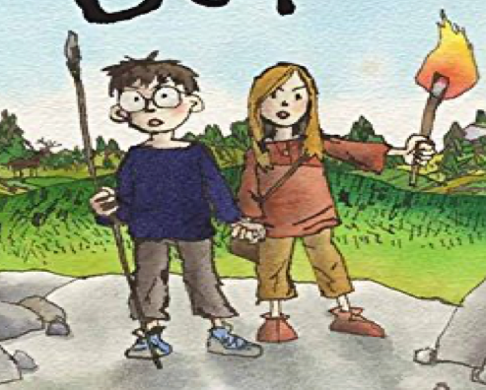
LI: To use expanded noun phrases to add additional detail

Slide 2
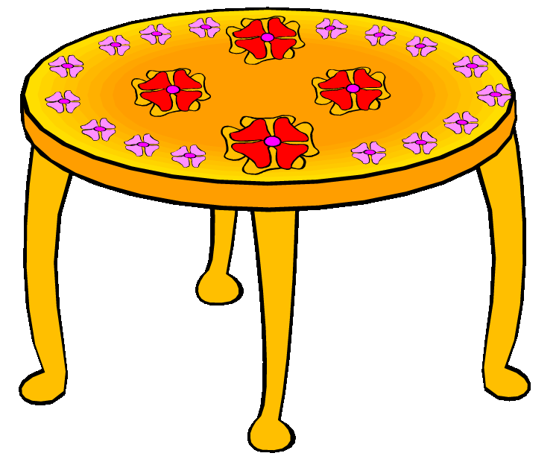
Noun phrase
A noun phrase is a group of two or more words that contains a noun but no verb to tell us what the noun is doing or feeling.
a table
the flowers

Slide 3
Expanded noun phrase
An expanded noun phrase is a noun phrase with extra details added.
Adjectives can be added to add more information.
a patterned table
the red flowers
Watch the video on expanded noun phrases https://www.bbc.co.uk/bitesize/topics/zwwp8mn/articles/z3nfw6f

Slide 4
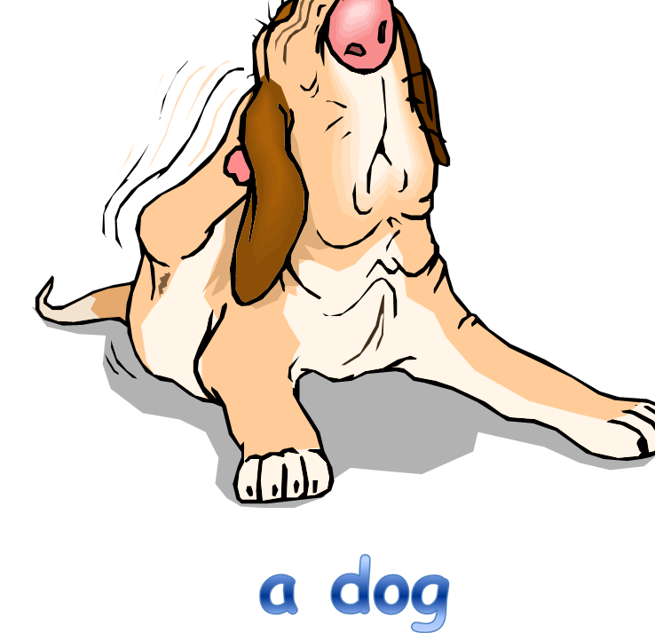
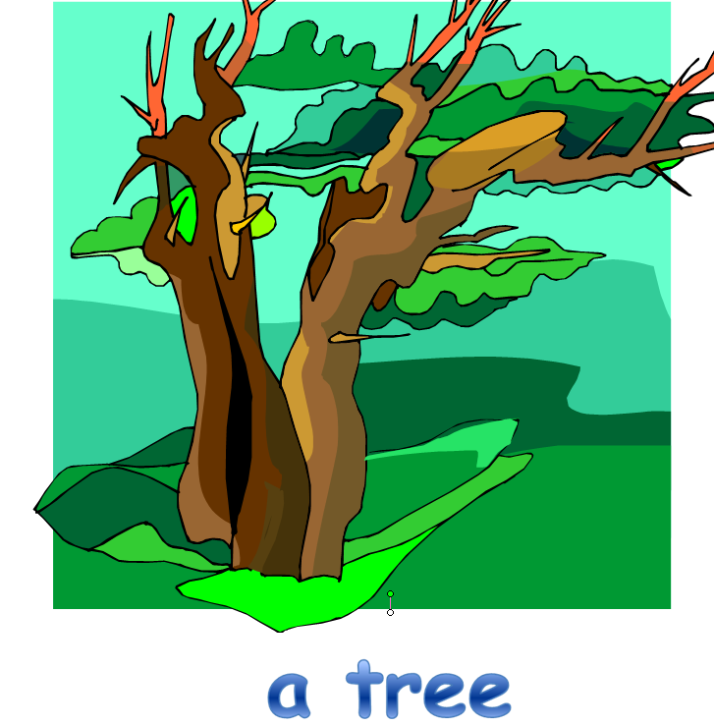

Make these noun phrases into expanded noun phrases by adding adjectives.
Have a go – use adjectives to make expanded noun phrases
………………………………………………………………………………………………………………………………………………………………………………………...........................................................................................
………………………………………………………………………………………………………………………………………………………………………………………...........................................................................................
………………………………………………………………………………………………………………………………………………………………………………………...........................................................................................

Slide 5
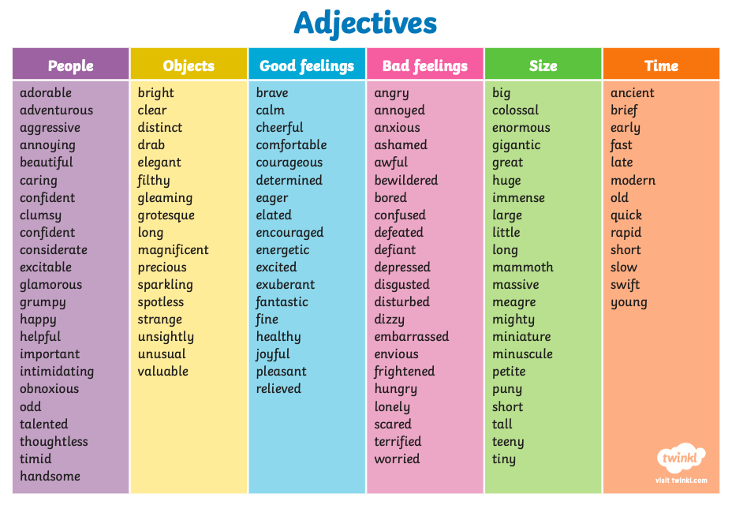

Slide 6
Activity
1. Draw the girl or the boy.
2. Write 6 expanded noun phrases to describe your character. You can use the nouns below and the adjectives word mat to help you or you can choose you own ones.
3. Write a paragraph of your character description using your chosen expanded noun phrases and turn them into complete sentences.
5. Use capital letters, full stops and joined handwriting.
Nouns
boy
girl
glasses
hair
cave
spear
torch
glasses
top
Noun Phrase
The boy
A girl
The glasses
The hair
The cave
A spear
The torch
The glasses
The top
Expanded Noun Phrases
Eg: The surprised boy ...
The Stone Age girl ...

