Slide 1


LI: To use reasoning and problem solving skills.
© Classroom Secrets Limited 2018

Slide 2
Reasoning 1
Find the odd one out by matching
three pairs.
Hundreds | Tens | Ones
1
1
100
100
10
10
672
1
1
100
100
10
1
1
708
Six hundred and seventy-two.
452
Hundreds | Tens | Ones
436
© Classroom Secrets Limited 2018

Slide 3
Reasoning 1
Find the odd one out by matching
three pairs.
Hundreds | Tens | Ones
1
1
100
100
10
10
672
1
1
100
100
10
1
1
708
Six hundred and seventy-two.
452
Hundreds | Tens | Ones
436
© Classroom Secrets Limited 2018

Slide 4
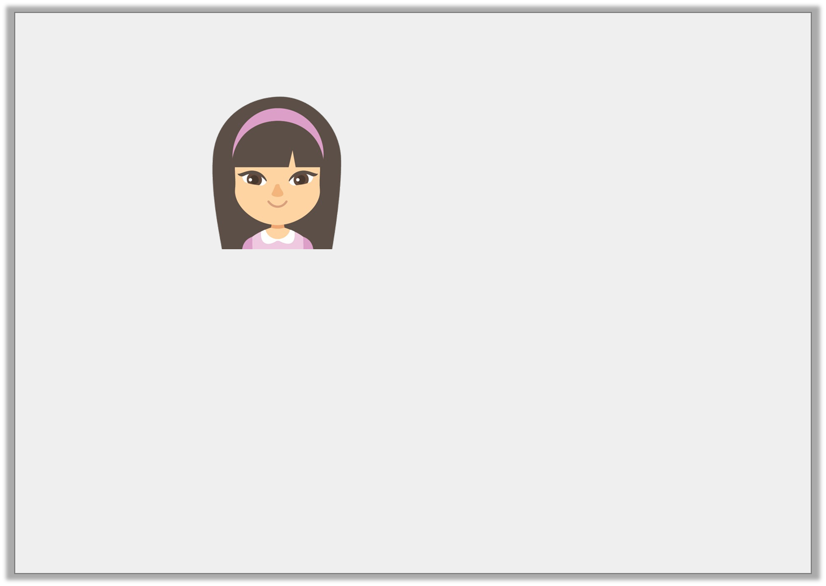
Reasoning 2
Rachel says,
Do you agree? Explain why.
The number shown is 206.
Hundreds | Tens | Ones
100
100
1
1
1
1
© Classroom Secrets Limited 2018

Slide 5
Reasoning 2
Rachel says,
Do you agree? Explain why.
I disagree because…
The number shown is 206.
Hundreds | Tens | Ones
100
100
1
1
1
1
© Classroom Secrets Limited 2018

Slide 6
Reasoning 2
Rachel says,
Do you agree? Explain why.
I disagree because there are only 4 ones in the ones column. The number shown is 204.
The number shown is 206.
Hundreds | Tens | Ones
100
100
1
1
1
1
© Classroom Secrets Limited 2018

Slide 7
Problem Solving 1
Create 3-digit numbers using 3 counters.
Your numbers must have a
0 in the ones column.
Hundreds | Tens | Ones
© Classroom Secrets Limited 2018

Slide 8
Problem Solving 1
Create 3-digit numbers using 3 counters.
Your numbers must have a
0 in the ones column.
Possible answers: 300, 210, 120
Hundreds | Tens | Ones
© Classroom Secrets Limited 2018

